Slide 1
Science Communication –
How to Communicate Food Science to Different Audiences
Developed by: Yael Rozenblum, Dr. Keren Dalyot, and Dr. Yael Barel-Ben David

Slide 2
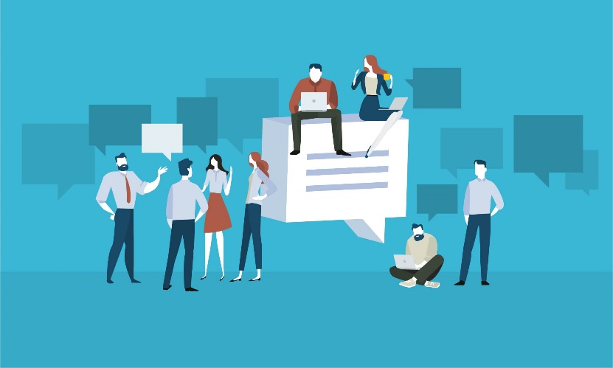
On the Agenda
What is communication?
What is science communication?
Tools for effective science communication

Slide 3





Let's get to know each other

Slide 4
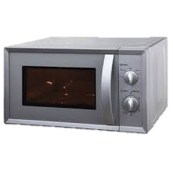
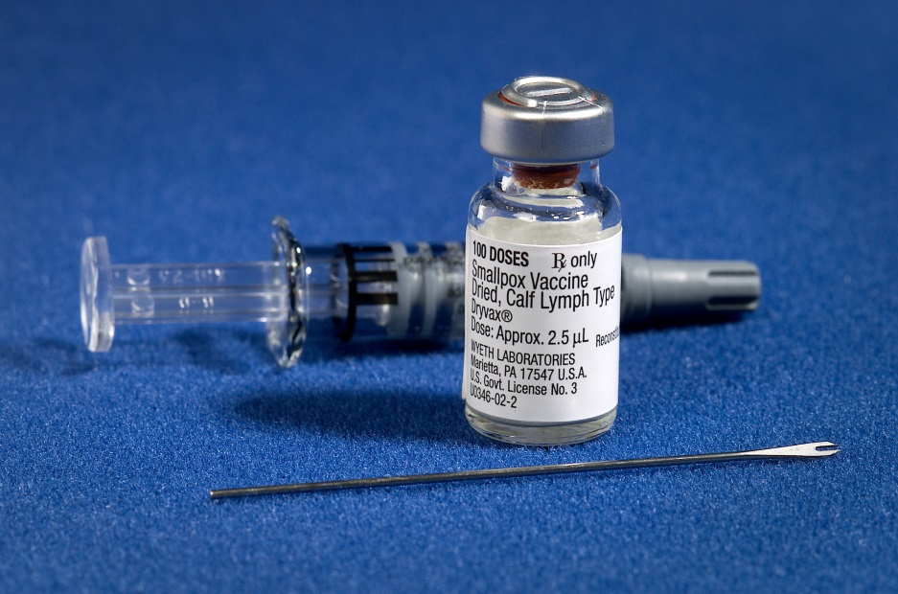
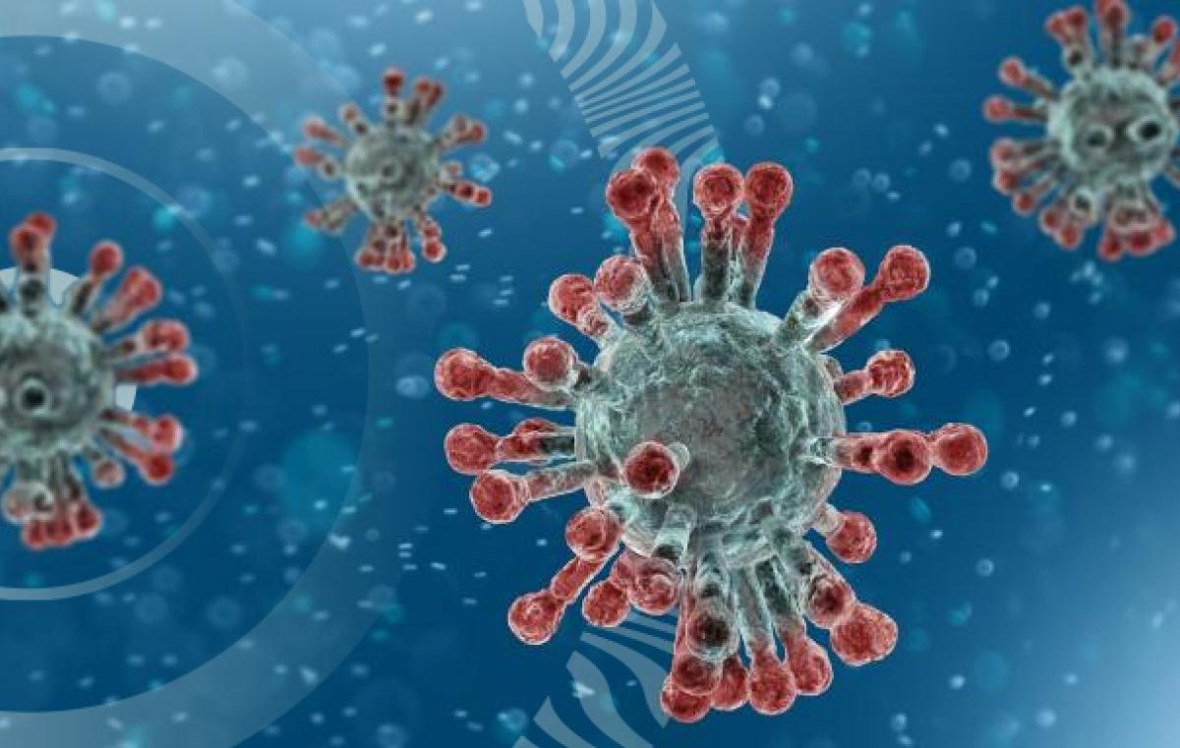
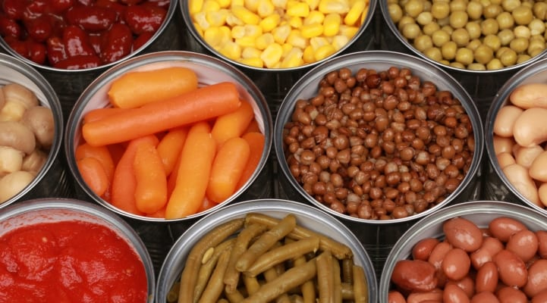
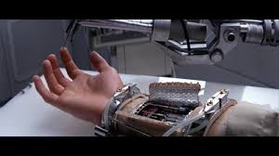
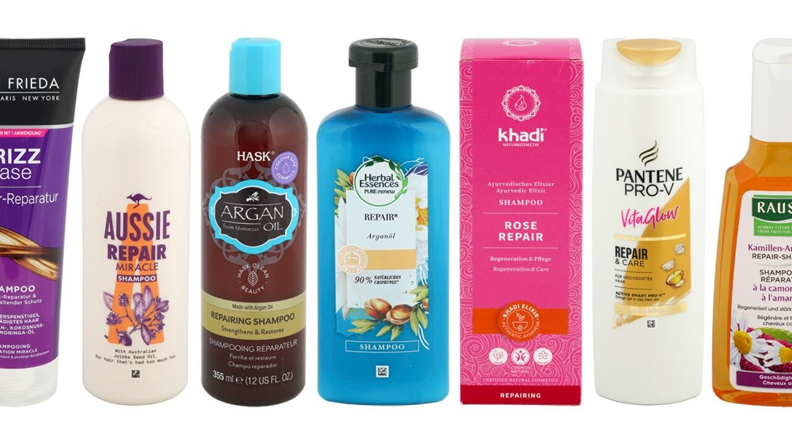
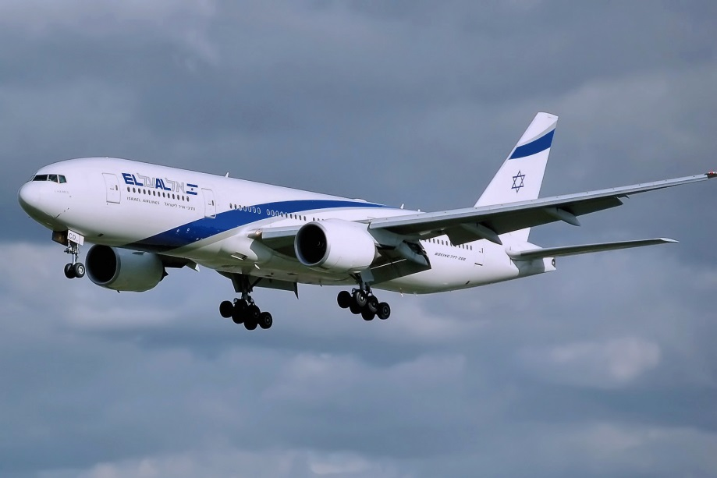
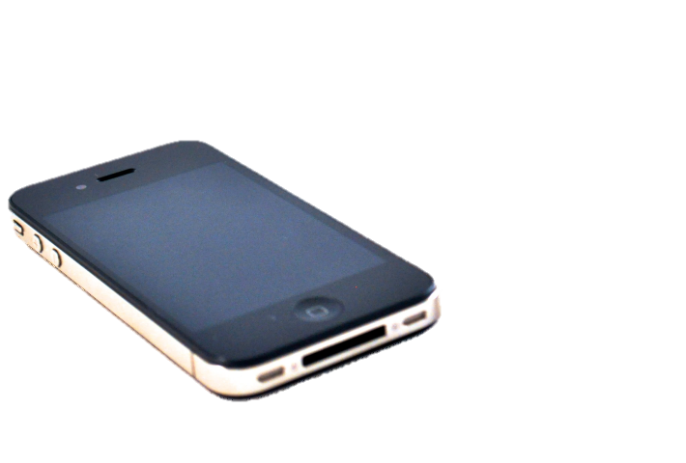
Science in Everyday Life

Slide 5
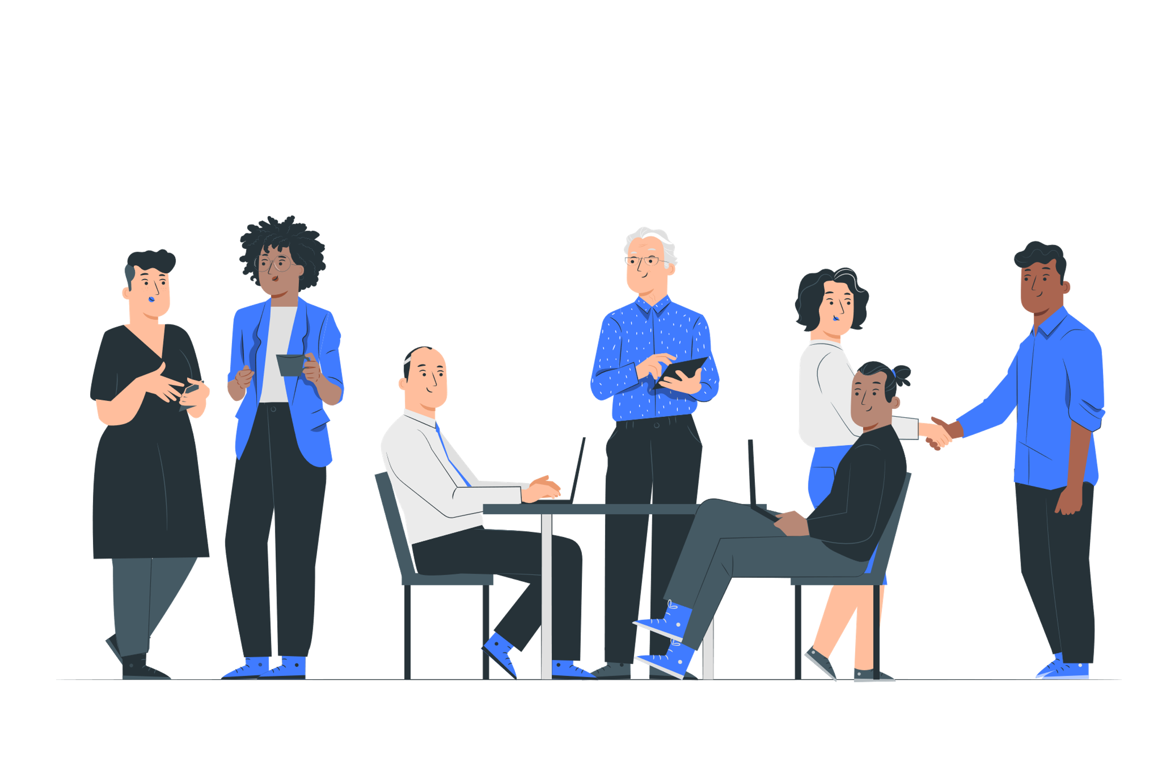

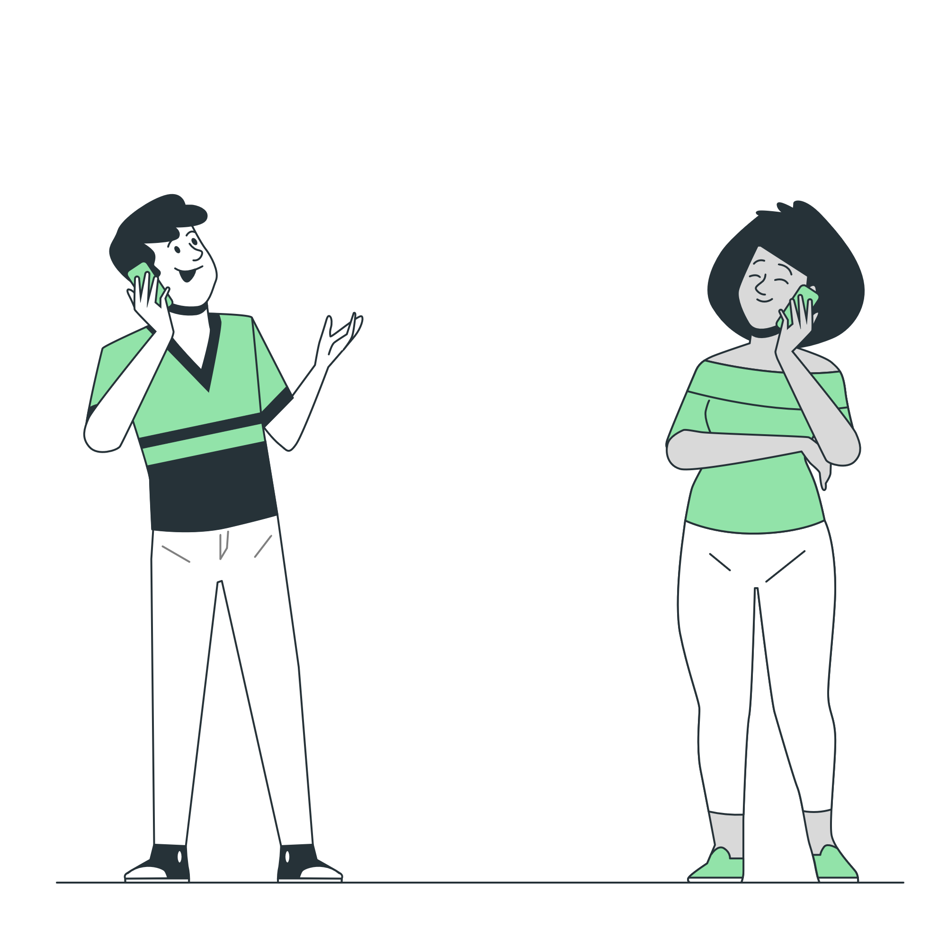
Who is communicating and how?
1
2
3
5
7
10
4
8
6
9
<a href="https://stories.freepik.com/app">Illustration by Freepik Stories</a>

Slide 6
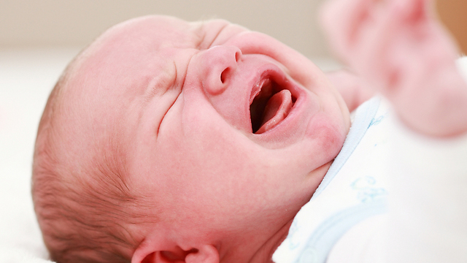
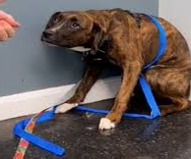

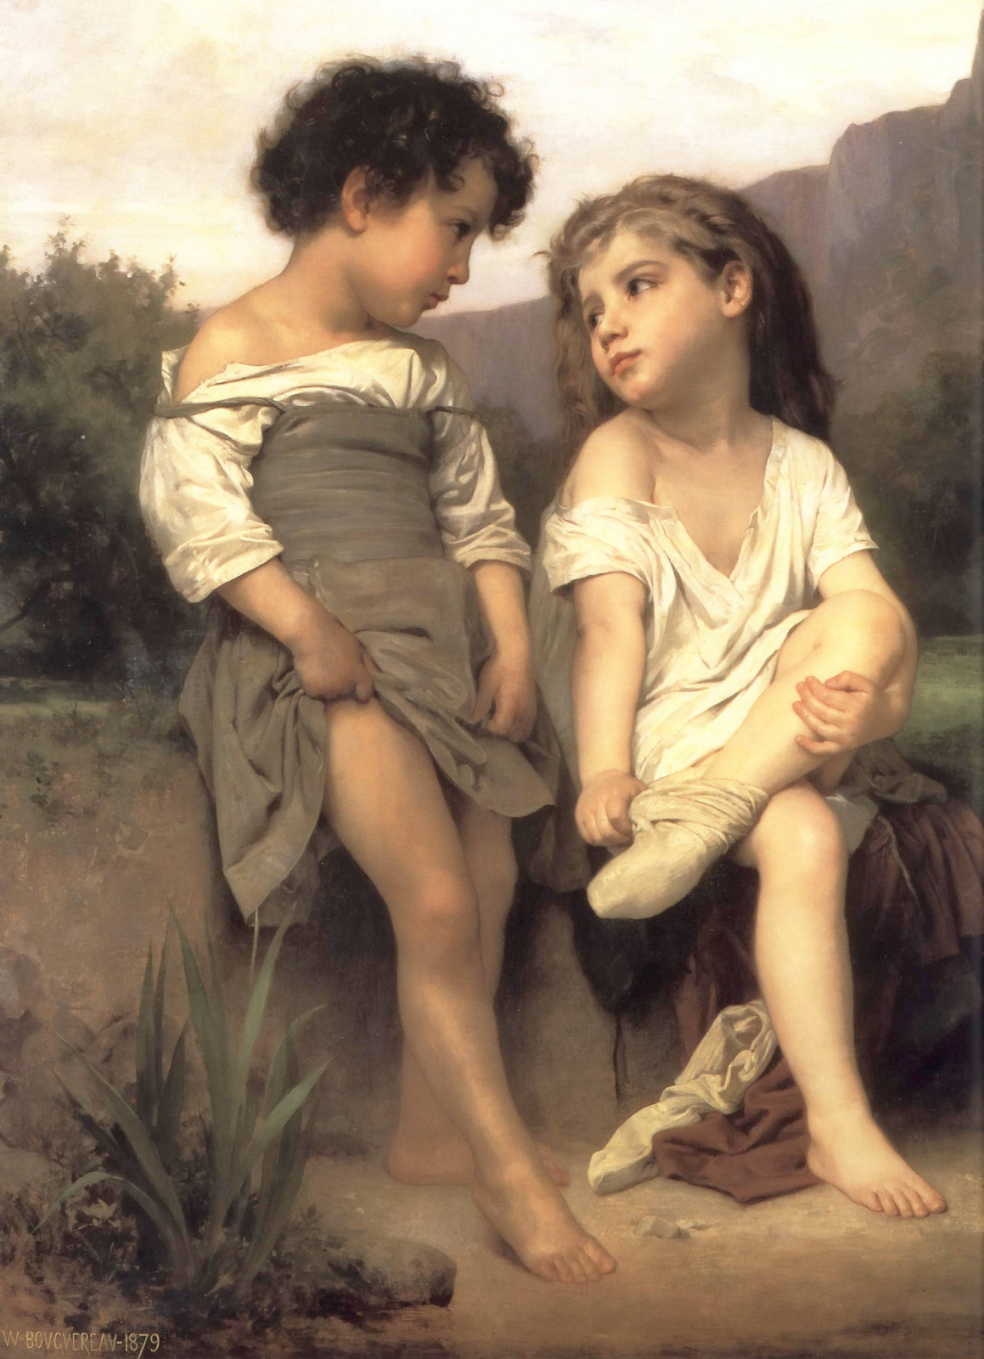
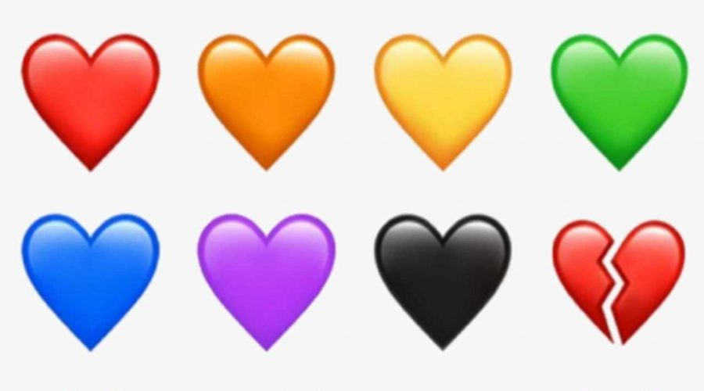


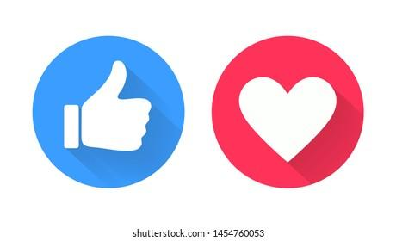
In which of the pictures is there communication and what kind?
3
1
2
7
4
5
6
8
Pictures from: Ynet, Davidson institution and AAURICA , WIKIPEDIA,

Slide 7
On the Agenda
What is communication?
What is science communication?
Tools for effective science communication

Slide 8
Communication
‘A process by which information is exchanged between individuals through a common system of symbols, signs or behaviors’
https://www.merriam-webster.com/dictionary/communication

Slide 9
Science Communication
‘The accurate and undistorted conveyance of ideas, insights, facts, and analytical frameworks derived from science to anyone who has a need to understand them.’
Guidotti, T. L. (2016). Communication in Science. Journal of the Washington Academy of Sciences, 102(3), 23–36. https://www.jstor.org/stable/90013563

Slide 10
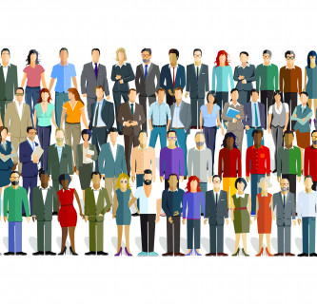
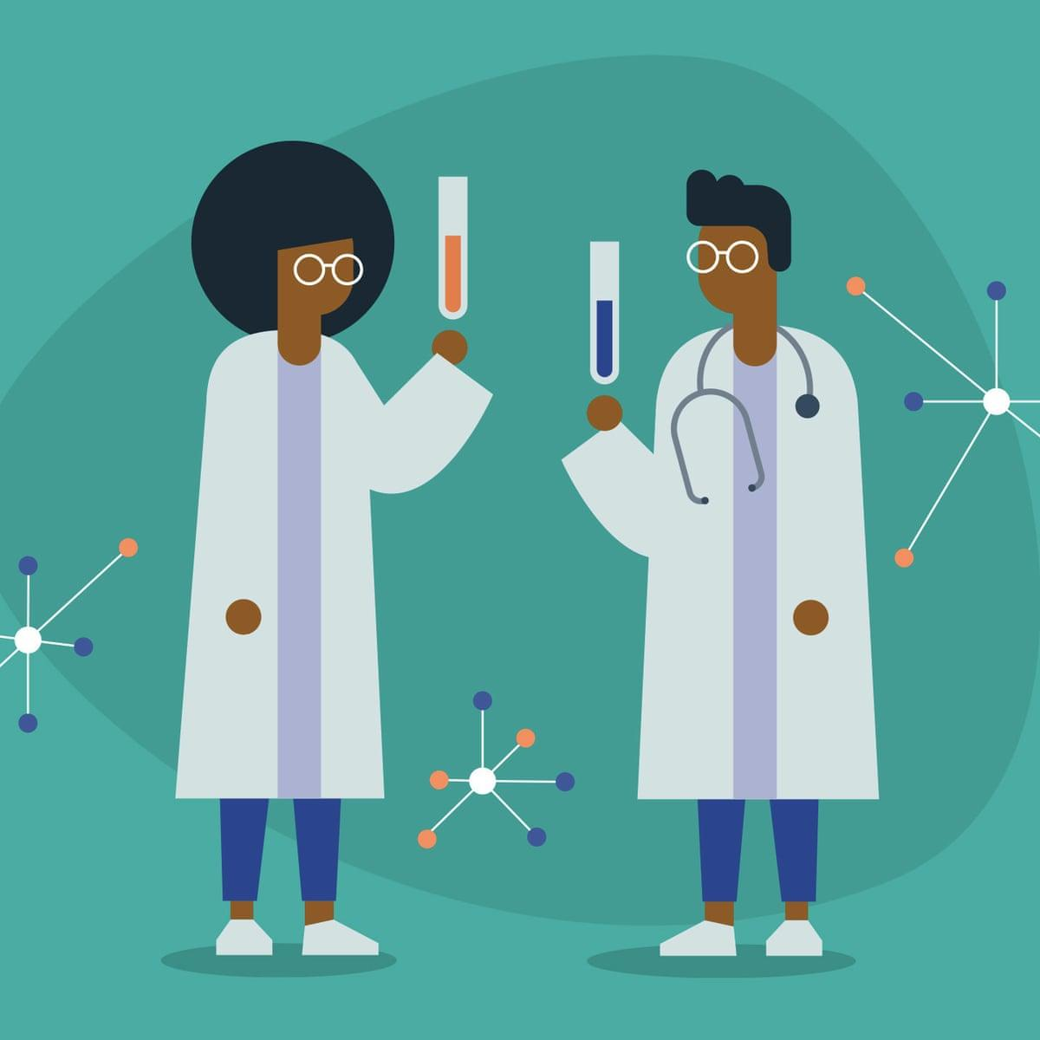

Who communicates science ?
Sources of images: https://www.theguardian.com/science/2021/apr/10/why-are-there-still-so-few-black-scientists-in-the-uk, https://dobienews.scuc.txed.net/23829/news/why-journalism-is-important/ , https://www.fh-joanneum.at/public-communication/postgraduate/en/

Slide 11
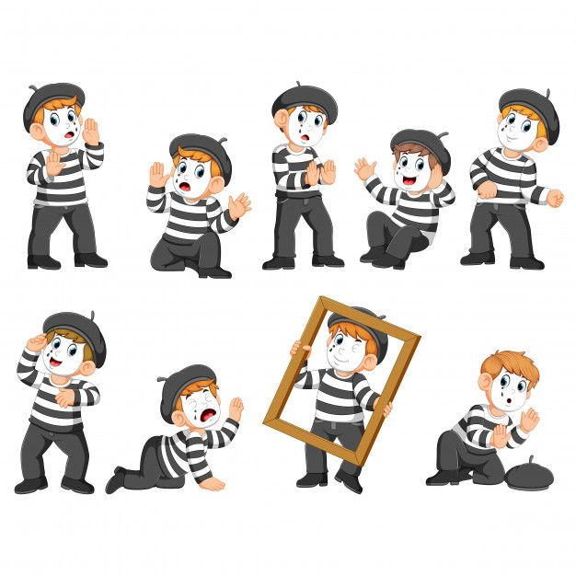
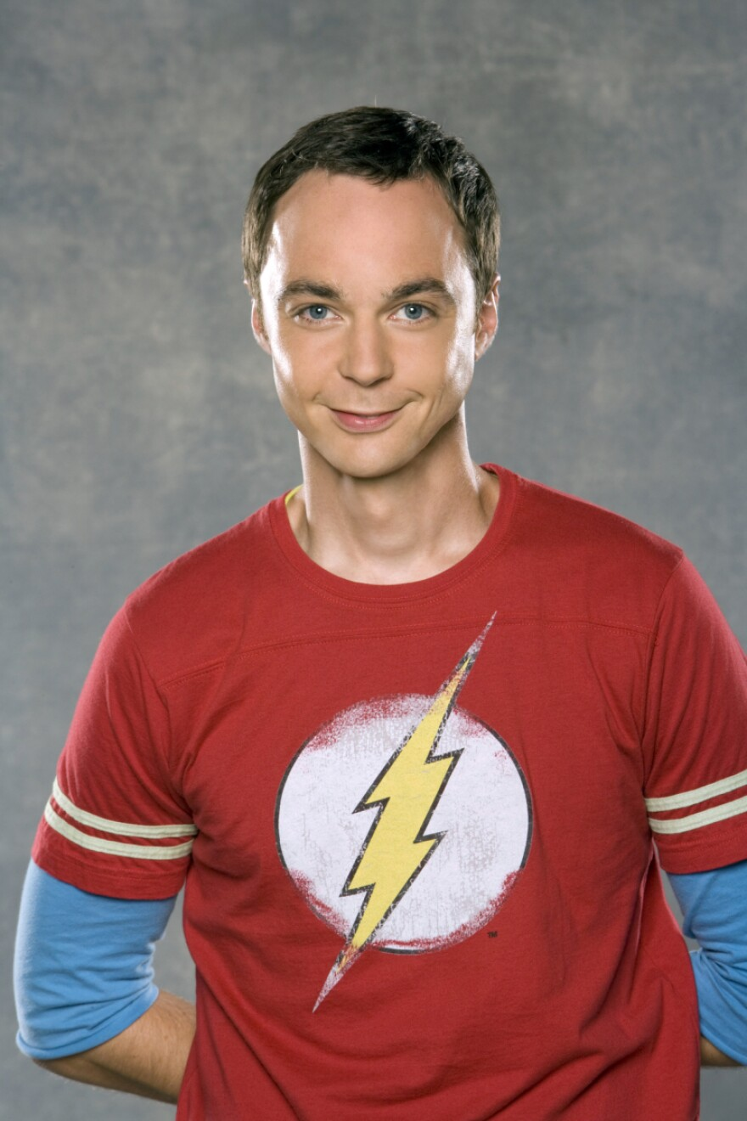
“Charades”- Pantomime
The Big Bang Theory – Sheldon explains the Doppler effect https://www.youtube.com/watch?v=fUPOxK55nm0

Slide 12
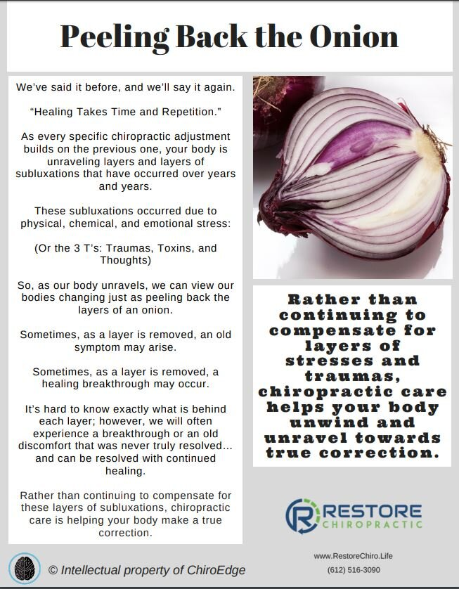
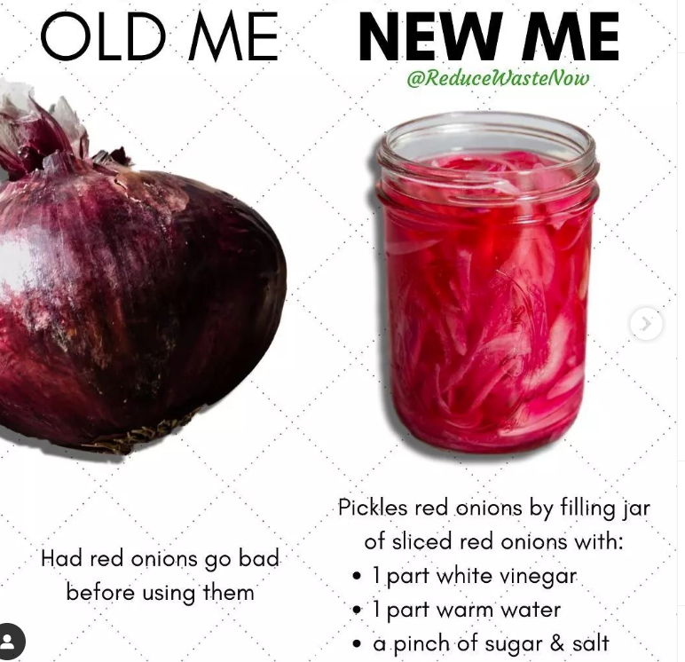
2
Which Post is Better?
1

Slide 13
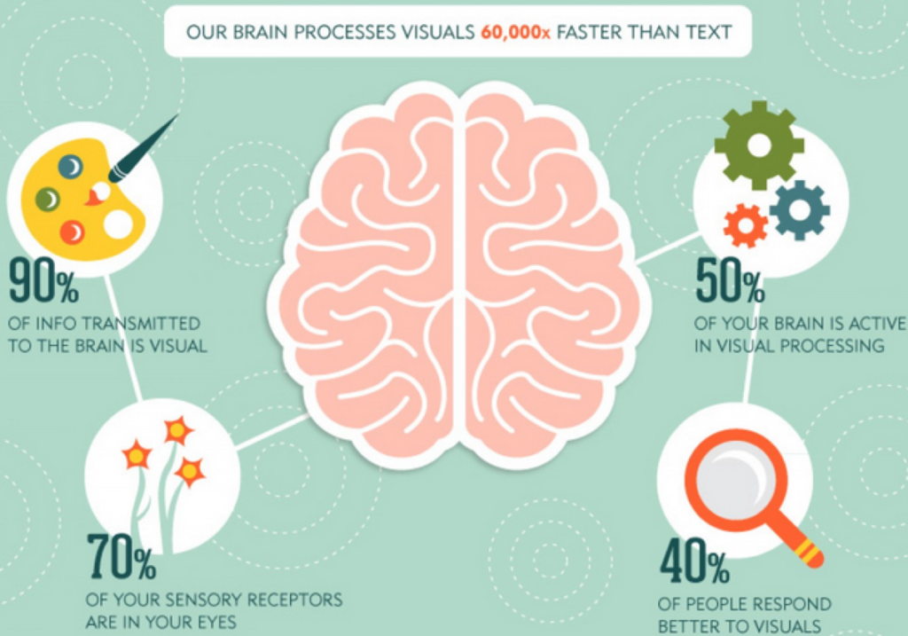
Source of image: http://www.infopixi.com/blog/types-of-visual-content/

Slide 14
Tips and tools for effective science communication
What is your goal? What is your message?
Who is your audience?
Avoid technical words
Curse of knowledge
Personal connection
Day-to-day examples
Visualization
Remember, if the message did not go through it is not the audiences’ fault

Slide 15
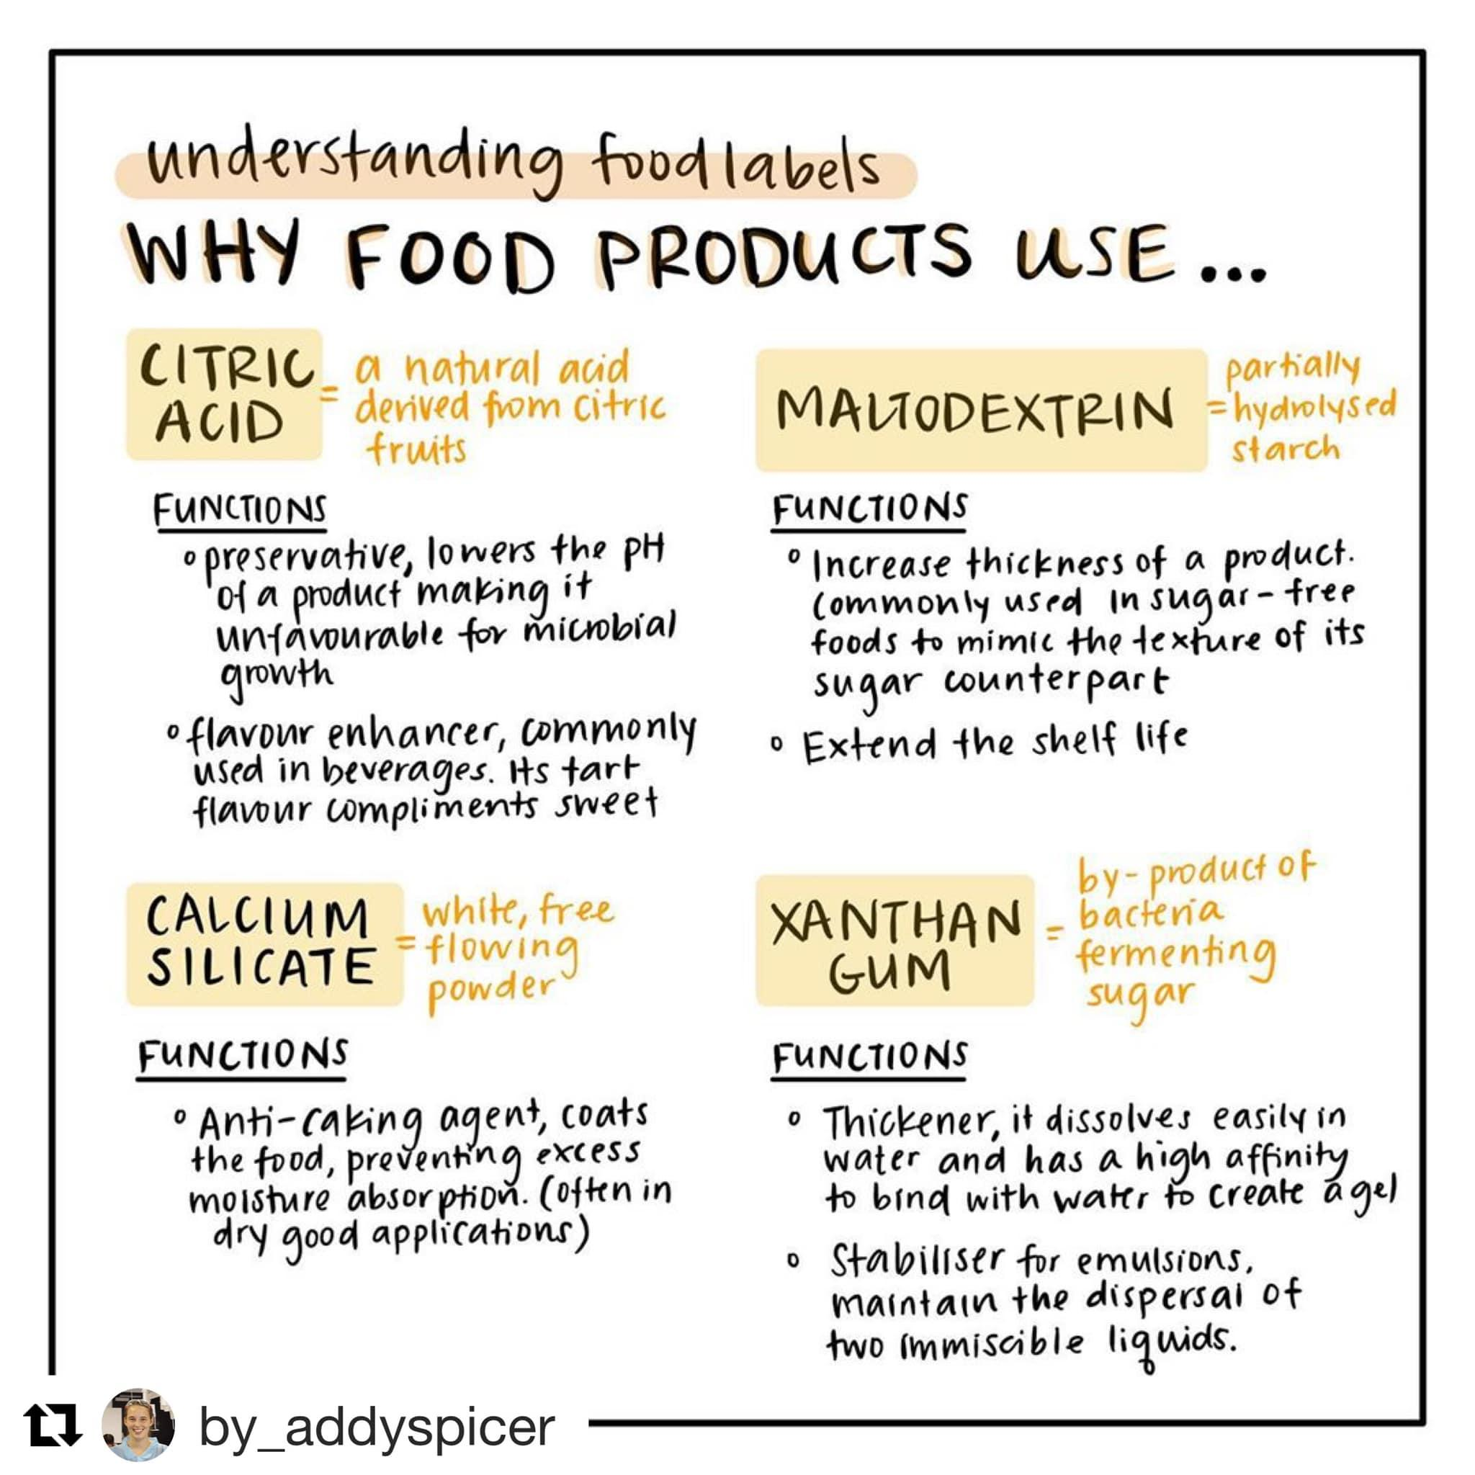
What do you think about this post?

Slide 16
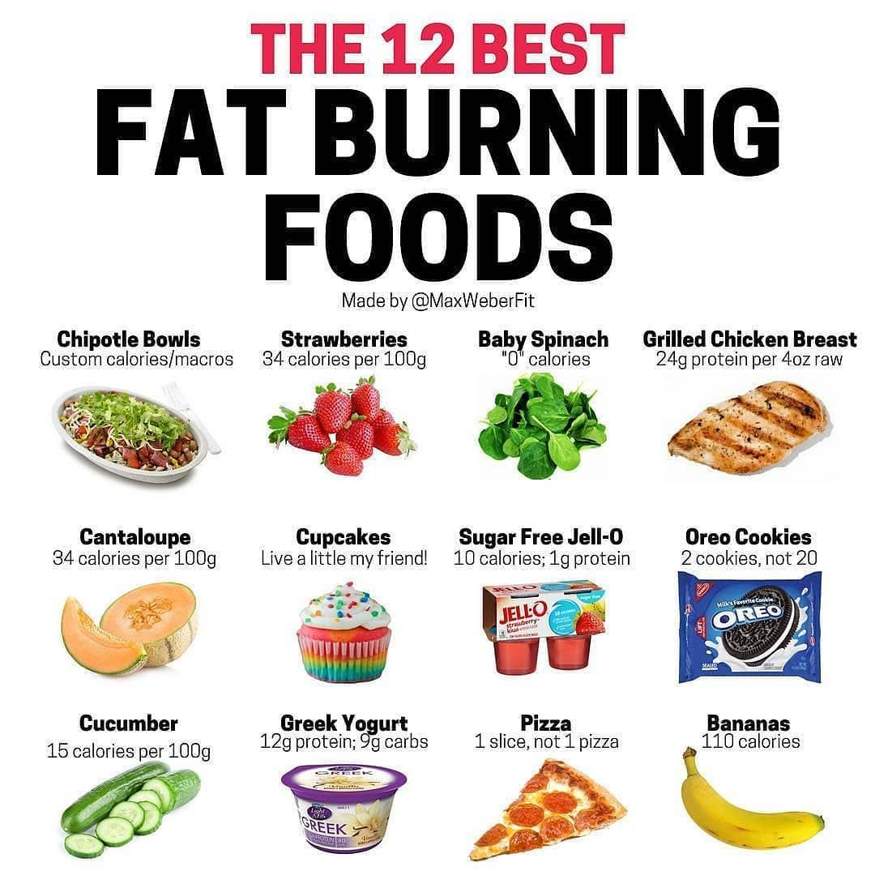
What do you think about this post?

Slide 17
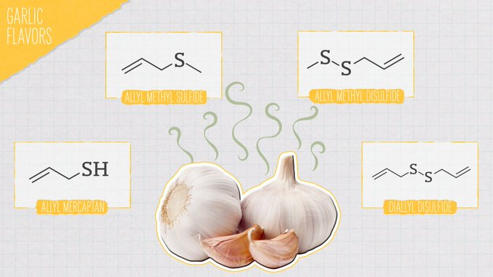
What do you think about this post?
_bookchemistry - https://www.instagram.com/p/CdBXMXaqm3V/?igshid=YmMyMTA2M2Y%3D

Slide 18
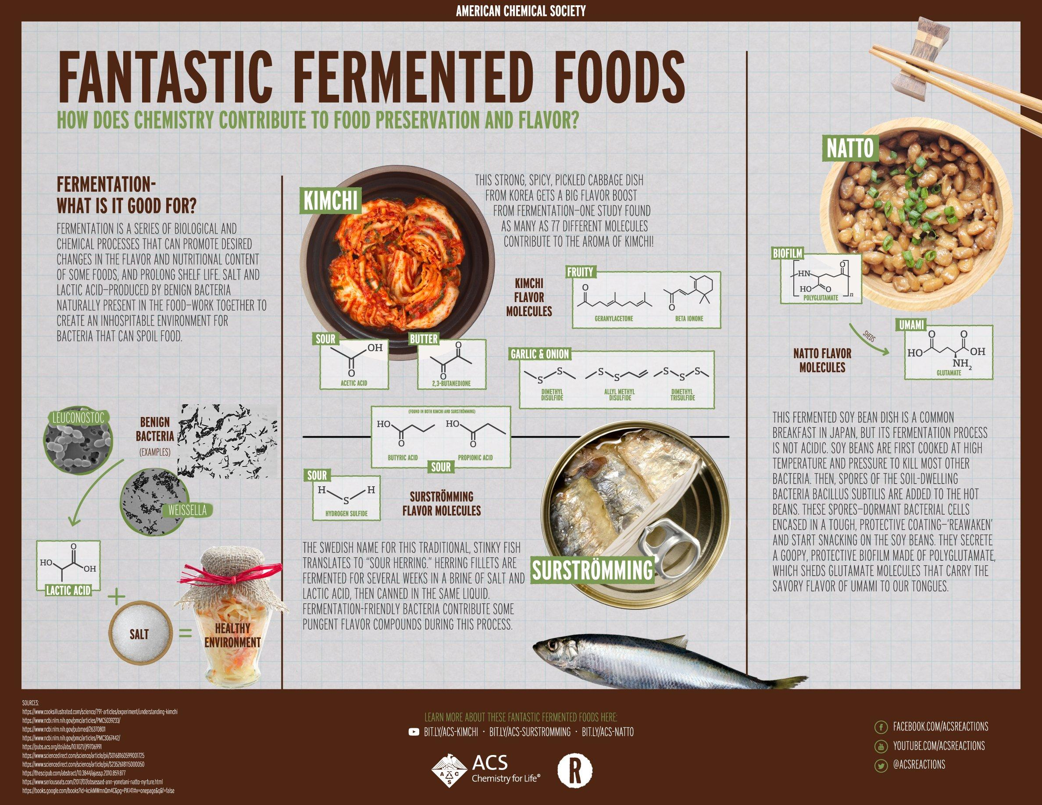
What do you think about this post?

Slide 19
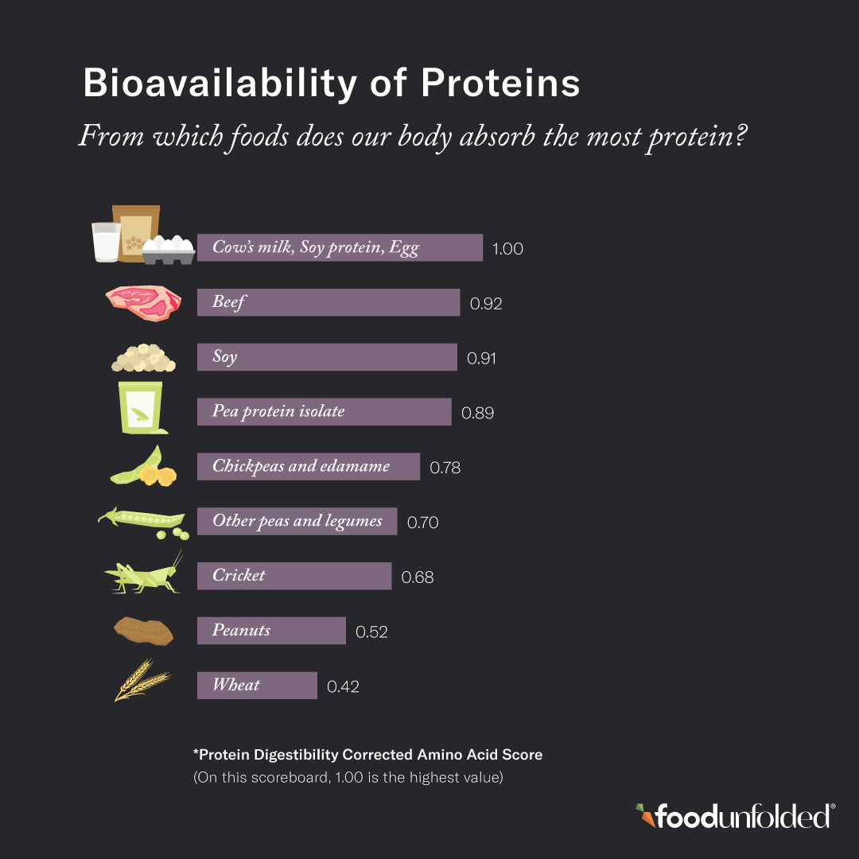
What do you think about this post?
Source: @FoodUnfolded Instagram account

Slide 20
Summary: What have we discussed today?
Science in everyday life
What is communication and what different types of communication are there?
What is science communication?
Who needs to communicate science and why?
Tools for effective science communication

Slide 21
Thank you!

